Slide 1
<Engagement Name>
Weekly Stakeholder’s Status Report
Presenter's name
Date

Slide 2
Table of contents
Status and Progress
Risks
<add contents as relevant>
Appendix
Engagement Timelines
DB Migration Status
Q&A

Slide 3
Status, Progress & Risks
As of <Date>

Slide 4
Status
Project Summary: <Customer> has engaged AWS Professional Services to complete the migration of <Database(s) name> from <source DB> to <target DB eg. Amazon RDS for SQL Server>.
Status: RAG | Budget Used as of <Date> : $140,123 of $235,000 (% consumed)
Completed
DMS and RDS CFTs
DB Name Generalization
Script for Identity mismatch
RDS CFT CI/CD Integration
Auditing PoC
Ongoing
CI/CD Pipeline (DMS, Code Deploy)
User and Roles Migration
Auditing Requirements Review
Planned Next
Functional Testing
User Migration and Auditing requirements implementation
CI/CD Pipeline readiness
QA Start
Type | Description | Date Added | Status | Impacts | Mitigation Plan | Owner
Risk
Risk

Slide 5
Appendix

Slide 6
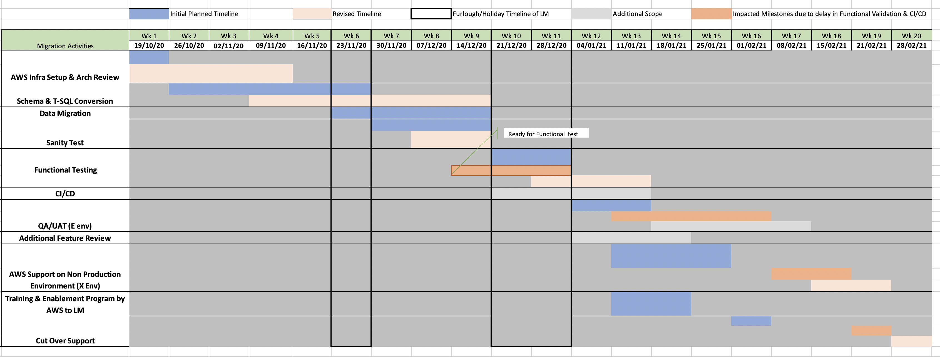
Engagement Timelines

Slide 7
DB Migration Status
Database Name | Schema Name | Status
DBName_A | Schema_aa | Complete
 | Schema_bb | In Progress
 | Schema_cc | In Progress
DBName_X | Schema_zz | Backlog

Slide 8
Q&A

